Slide 1
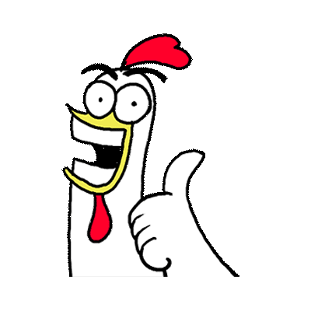
No Preparation: Fun and Effective Activities for Language Teachers
- Ireland

Slide 2

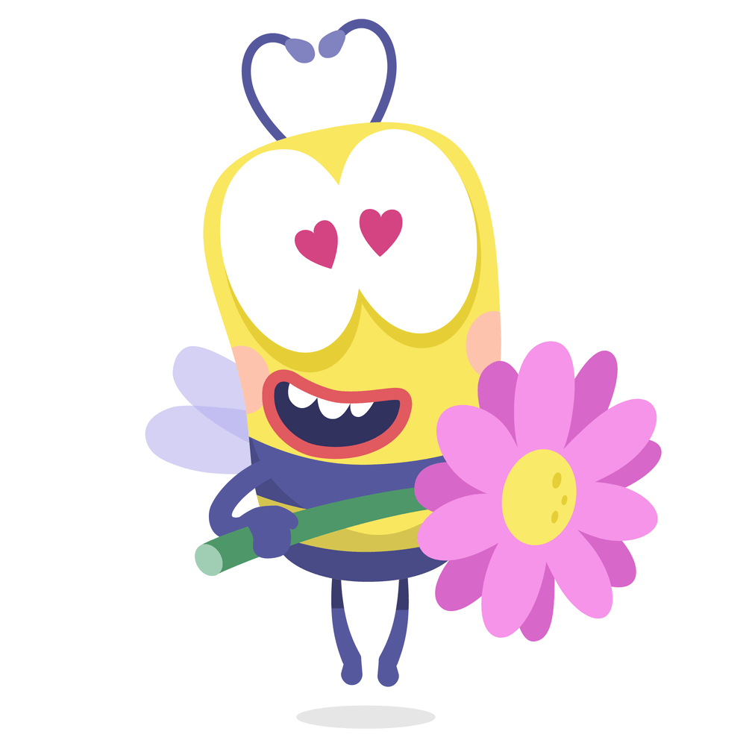
Useful activities:
NO
extra tools
internet
IT devices
time consuming
YES
- fun
energy
cooperation
interaction
language improvement

Slide 3
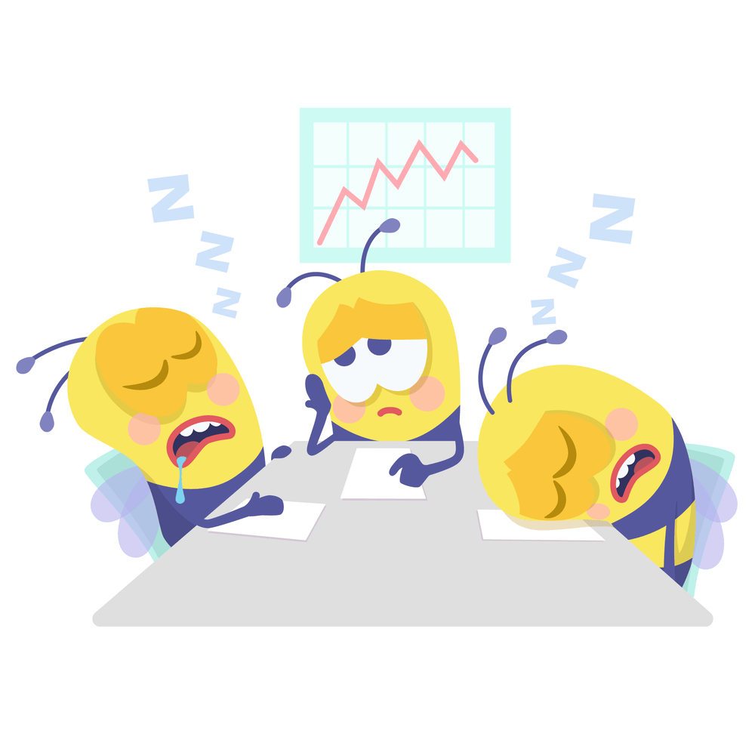
Effective communicational activities as…
Icebreakers:
Music mingle: find someone who has 3 things in common with you
Movements to act out: who you are and what you are doing
Link ups: Practicing set-up expressions
- I’m thankful for …
- It’s important to me …
Pronunciation:
1) Tense and relax
2) Call and response
3) Sound stories

Slide 4
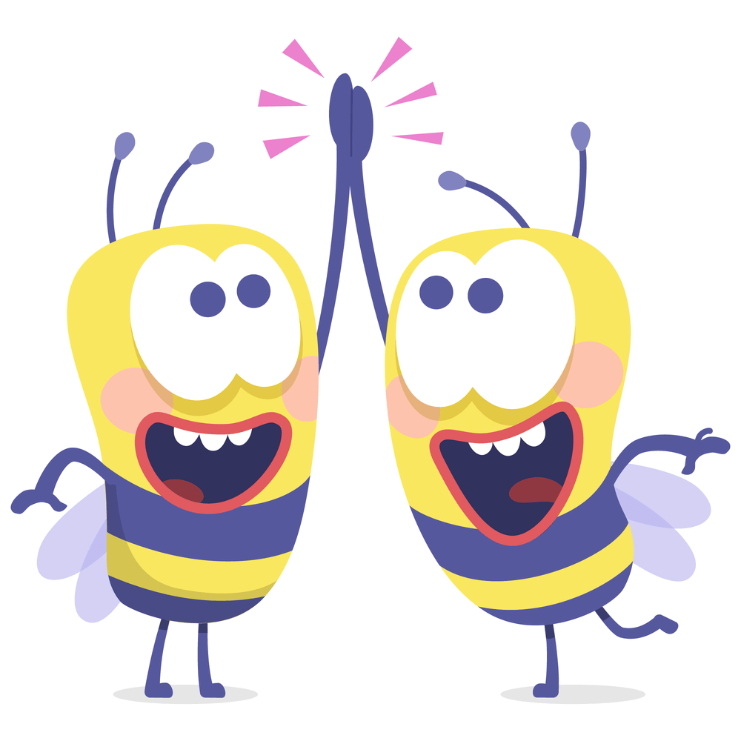
Drama in the classroom
1) Improvisation: accept and continue: Let’s…
2) Walk/Sit as …..
3) Channel Hop
4) Tell me about
5) Goha the judge
- listen to a story
- listen and mime
- mime only
- act/tell the story
6) Scarf story: use a scarf as a stage set
7) Personal story: just the title

Slide 5
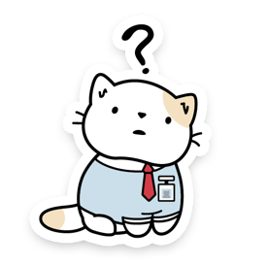
Final activities/HW:
1) Pair acting: one person behind another
2) Tutorial videos: How to do…..?
- record the instructions at home
- act it out in front of the class

Slide 6
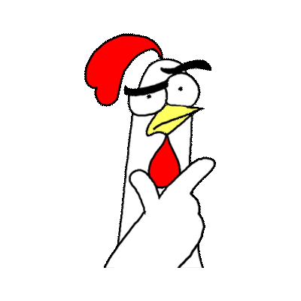
Useful pages:
bouncyballs.org
sunodownload.net
chatterpix

